Slide 1
Udacity Connect Session
April 21, 2018
Reinforcement Learning

Slide 2
Welcome back!

Slide 3
Morning Schedule
10:00 - 10:30 | Housekeeping and Review
10:30 - 11:00 | Policy Iteration
11:00 - 11:30 | Temporal Difference Learning
11:30 - noon | Exploration vs Exploitation
© 2016 Udacity. All rights reserved.

Slide 4
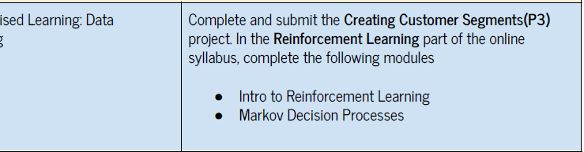
Reinforcement Learning

Slide 5
Reinforcement Learning
OUTLINE
Define the problem
RL Framework and Terminology
Describe some solutions
- First, intuitively
- Second, more formally

Slide 6
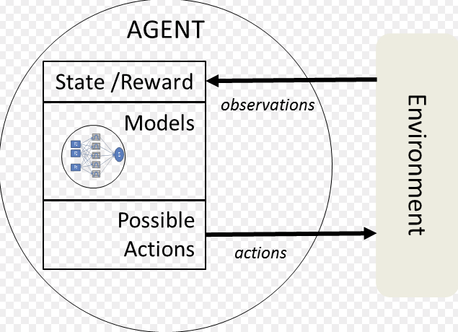
Intelligent Agents - Minimalist

Slide 7
Terminology
DEFINITIONS
STATES
ACTIONS
REWARDS
VALUE
RETURN/UTILITY
POLICY

Slide 8
Formulate Problem using MDP
Set of states S (finite number)
Set of actions A (fInite)
Set of rewards R (finite), formally R(s,a)
Dynamics - transition state T(s, a, s’) -- conditional probability
First order Markov -- do not need to consider past history

Slide 9
Grid World
ACTIONS - U (UP), D (DOWN), L (LEFT) R (RIGHT)
 | 1 | 2 | 3 | 4
c
b
a | X

Slide 10
MDP - Graph Model
GRID WORLD
U, p=0.8, r=-0.04
L, p=0.1, r=-0.04
R, p=0.8,
r = + 1.0
a,1
b,1
c,1
c,2
c,3
c,4
D, p=0.1, r=-0.04
R, p=0.8, r=-0.04
b,3
b,4
a,2
a,3
a,4

Slide 11
Goal - Reward Hypothesis
An RL agent’s goal can be cast as maximizing expected cumulative reward
Maximize (not less than any other “path”)
Expected (in a statistical sense)
Cumulative (total all rewards in the “future”)
Reward ???

Slide 12
Action-value Function
V_{𝜋}(s) = E_{𝜋}[G_{t}|S_{t}=s]
q_{𝜋}(s,a) = E_{𝜋}[G_{t}|S_{t}=s, a_{t}=a]
For each state s,
Expected return
If agent starts in state s
Uses the policy 𝜋
To choose actions for all time steps
For each state s and action a,
Expected return
If agent starts in state s
then chooses action a
And Uses the policy 𝜋
To choose actions for all time steps

Slide 13
Policy
SOLUTION TO MDP
Deterministic 𝜋 : S → A
Stochastic 𝜋 : S x A → [0,1]

Slide 14
Optimal Policy
DEFINITIONS
Policy 𝜋’ is better than policy 𝜋 if the following is true:
V_{𝜋’} (s) ≥ V_{𝜋}(s) for all states s ∊ S
There is at least one policy which is “better” than every other
Optimal policy is denoted as 𝜋* by convention (may not be unique)
Solution of the MDP
Optimal state-value function is v*(s) (by convention)

Slide 15
State Value Function
ACTIONS - {U, D, L R} R - {-0.1 (W), -0.3 (GRAY)
 | 1 | 2 | 3 | 4
c |  |  |  | +1.0
b |  |  |  | -1.0
a |  | X | 0.8

Slide 16
State Value Function
ACTIONS - {U, D, L R} R - {-0.1 (W), -0.3 (GRAY)
 | 1 | 2 | 3 | 4
c | 0.8 | 0.9 | 1.0 | +1.0
b | 0.7 | 0.6 | 0.9 | -1.0
a | 0.6 | X, 0.5 | 0.4 | 0.3

Slide 17
Bellman Expectation Equation
V_{𝜋}(s) = E_{𝜋}[R_{t} + 𝛾V_{𝜋}(S_{t+1})|S_{t}=s]
For each state s,
Expected Immediate Reward of state s
Discounted Value of new state S_{t+1} (dictated by policy 𝜋)

Slide 18
Policy Evaluation
MODEL-BASED
Given a MDP
Given an initial state
Using the reward hypothesis
Select a series of actions that will maximize the return

Slide 19
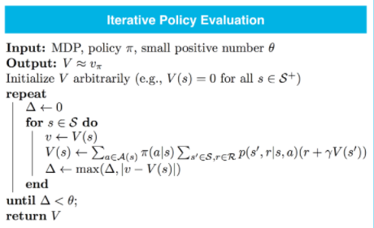

Slide 20
Policy Iteration
Policy 𝜋
Value V_{𝜋}
Policy 𝜋’ (V_{𝜋’} ≥ V_{𝜋})
Policy Evaluation
Policy Improvement

Slide 21
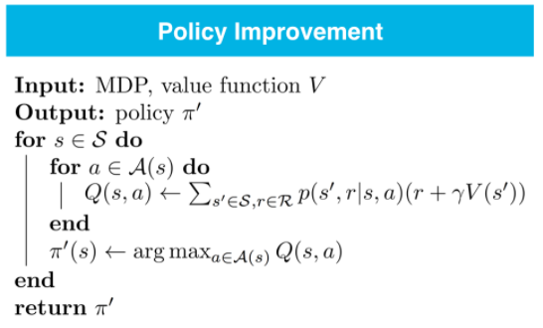

Slide 22
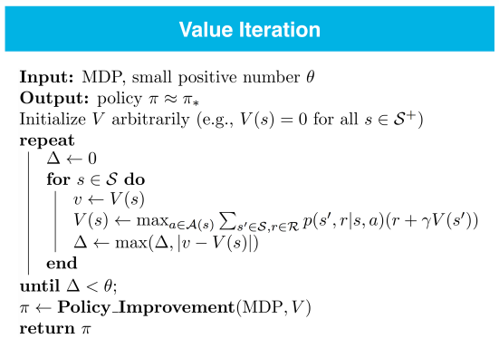

Slide 23
What if we don’t know MDP?
MODEL-FREE
Sample a number of episodes
Estimate V(s) or Q(s,a) from these samples
Choose a policy based on V(s) or Q(s,a)
Repeat until convergence

Slide 24
t₀, t₁, .., t_{i}, … t_{n}
S₀, S₁, .., S_{i}, … S_{n}
a₀, a₁, .., a_{i}, … a_{n}
R₀, R₁, .., R_{i}, … R_{n}
S₀, a₀, R₀, S₁, a₁, R₁, … S_{T}
S’₀, a’₀, R’₀, S’₁, a’₁, R’₁, … S’_{T}
S’’₀, a’’₀, R’’₀, S’’₁, a’’₁, … S’’_{T}

Slide 25
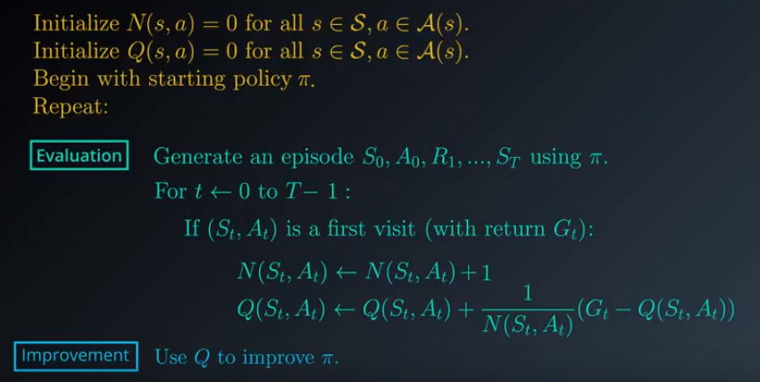

Slide 26

Iterative form of average
𝛼 - Learning Rate : 0 < 𝛼 < 1

Slide 27
What if episodes are long?
Greedy choice may not be optimal

Slide 28
Temporal Difference Learning
Q(S_{t}, A_{t}) ← Q(S_{t}, A_{t}) + 𝛼(G_{t} - Q(S_{t}, A_{t}))
V_{𝜋}(s) = E_{𝜋}[R_{t} + 𝛾V_{𝜋}(S_{t+1})|S_{t}=s]
Q(S_{t}, A_{t}) ← Q(S_{t}, A_{t}) + 𝛼(R_{t} + 𝛾Q(S_{t+1},A_{t+1}) - Q(S_{t}, A_{t}))

Slide 29
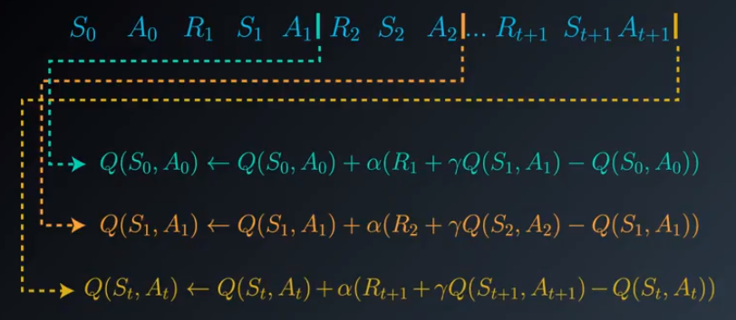
Temporal Difference Learning

Slide 30
Lunch Break

Slide 31
Afternoon Session
1:00 - 1:30 | Exploration vs Exploitation
1:30 - 2:00 | Q - Learning
2:00 - 2:50 | Project 4 Walkthrough
2:50 - 3:00 | Recap, Lookahead and Feedback
3:00 - 5:00 | Work on P3 / P4
© 2016 Udacity. All rights reserved.

Slide 32
Exploration vs Exploitation
GREEDY CHOICE MAY NOT BE OPTIMAL
 | A₁ | A₂ | A₃ | A₄
S₁ | 0 | 0 | 0 | 0
S₂ | 0 | 0 | 0 | 0
S₃ | 0 | 0 | 0 | 0
 | A₁ | A₂ | A₃ | A₄
S₁ | 0.1 | 0.5 | -0.5 | 0.7
S₂ | 1.0 | -0.5 | -2.0 | 0.2
S₃ | 0.1 | 0.8 | 0.5 | -0.4

Slide 33
Exploration vs Exploitation
GREEDY CHOICE MAY NOT BE OPTIMAL
 | A₁ | A₂ | A₃ | A₄
S₁ | 0 | 0 | 0 | 0
S₂ | 0 | 0 | 0 | 0
S₃ | 0 | 0 | 0 | 0
 | A₁ | A₂ | A₃ | A₄
S₁ | 0.1 | 0 | -0.5 | 0
S₂ | 0 | -0.5 | 0 | 0
S₃ | 0 | 0 | 0.5 | 0

Slide 34
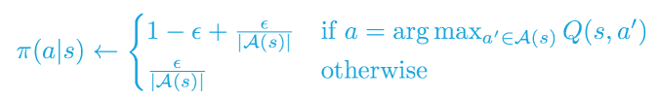
ε - Greedy Policy
Choose action based on max Q(s,a) estimate some of the time (1- ε)
Choose action randomly the rest (ε) of the time
0 < ε < 1

Slide 35
Temporal Difference Learning

Slide 36
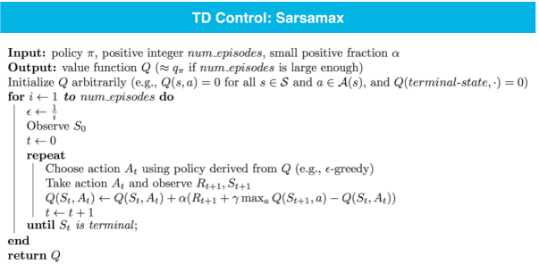
Q - Learning

Slide 37
Smartcab Project Walkthrough

Slide 38
Prep for next week
Smartcab Project (P4) due 4/28/18
Deep Learning - Lesson 1 pts 1-22

Slide 39
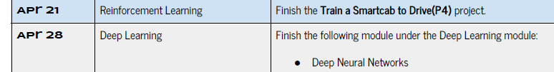

Slide 40

We really need your Feedback!
© 2016 Udacity. All rights reserved.

